Slide 1

An exposure weighted warming
Team: Marcin Gajewski, Salma Al-Zadjali, Yasna Palmeiro Silva

Slide 2
Methods
Analysis of UKCP18 dataset for:
Mean air temperature at 1.5m (°C)
Maximum air temperature at 1.5m (°C)
Minimum air temperature at 1.5m (°C)
In order to obtain meaningful results, we used monthly data.
Based on the data, we calculated temperature anomalies, considering a historical baseline of 20 years (1980-2000).
In order to calculate population-weighted average anomalies, we used population estimations from 2000 onward.

Slide 3
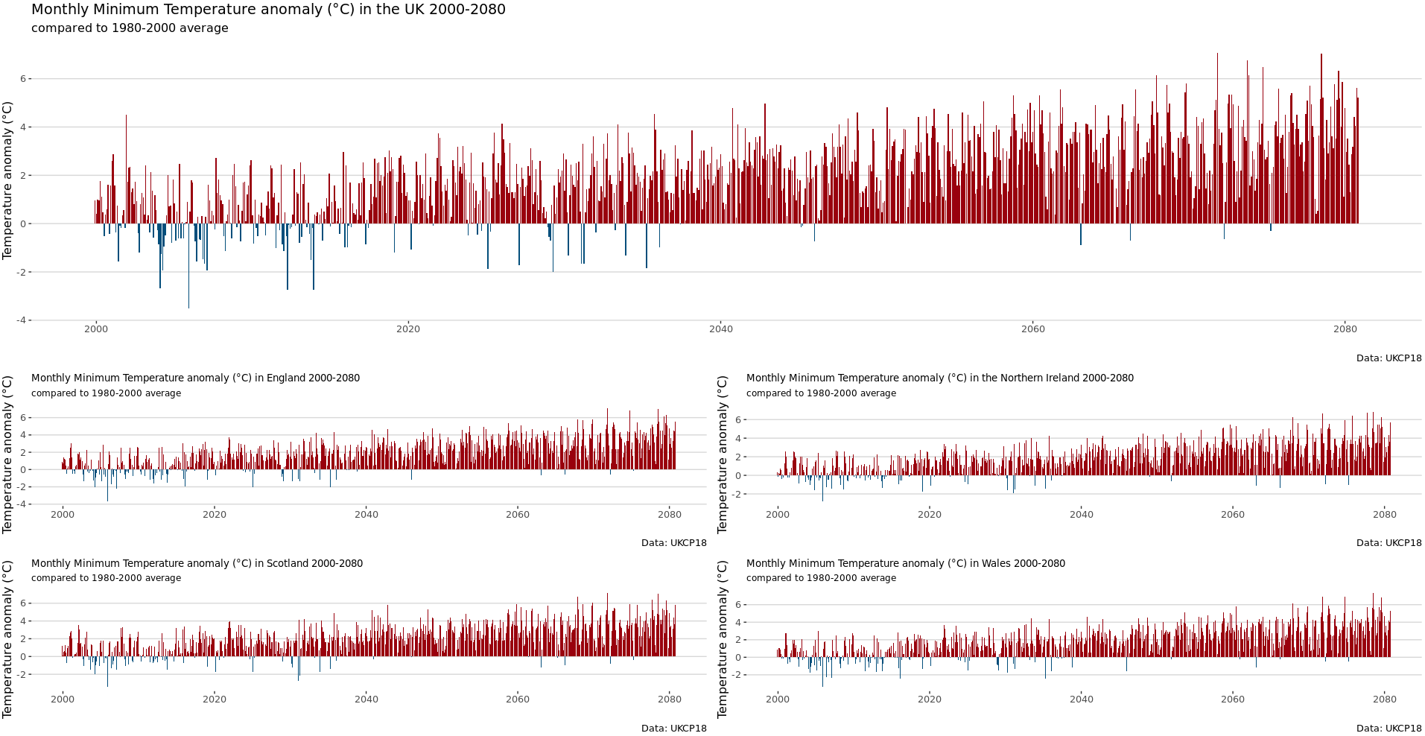

Slide 4
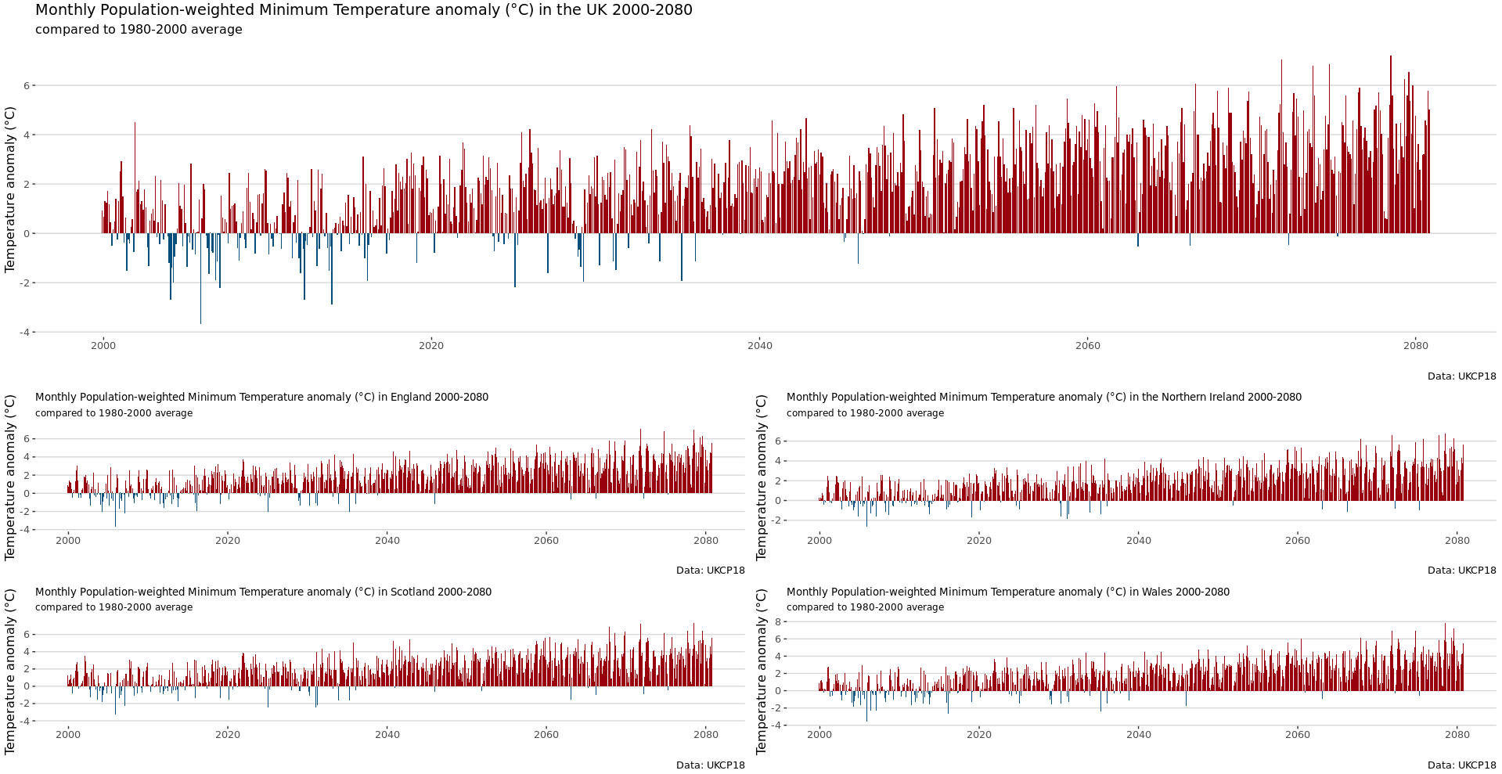

Slide 5
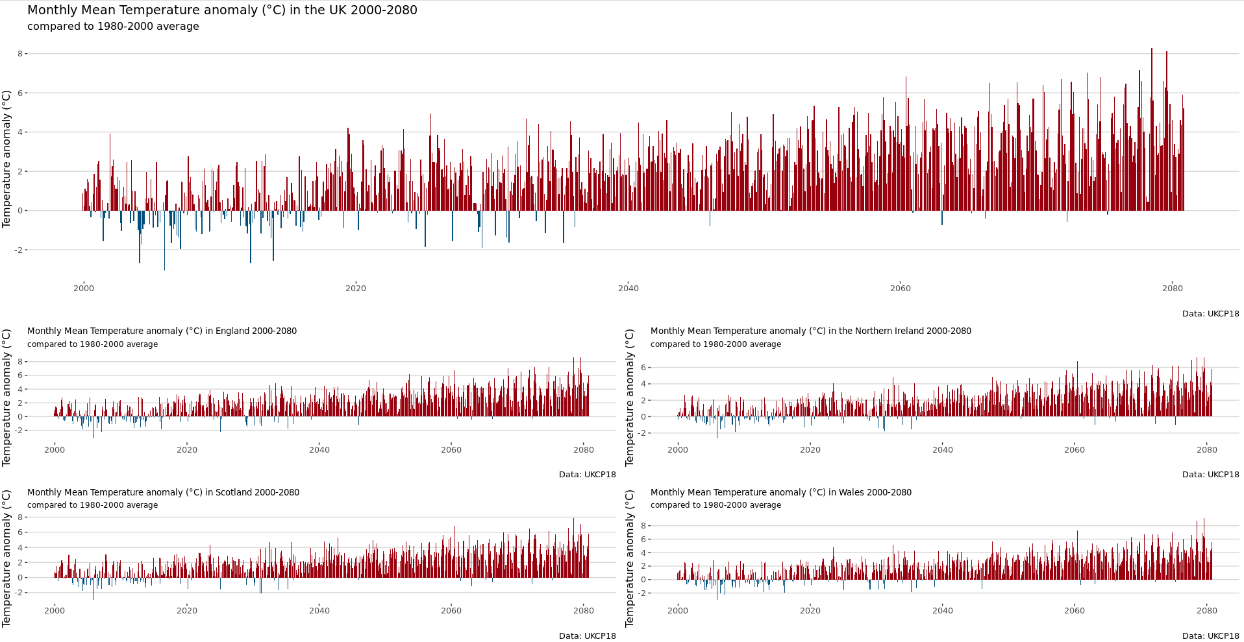

Slide 6


Slide 7
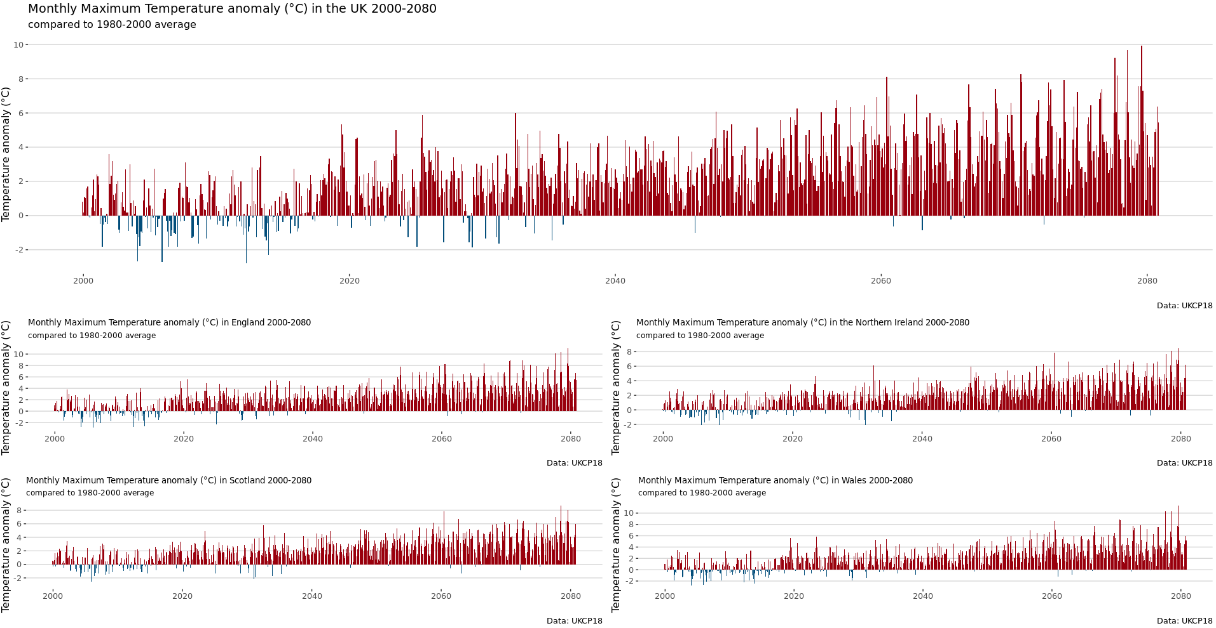

Slide 8


Slide 9
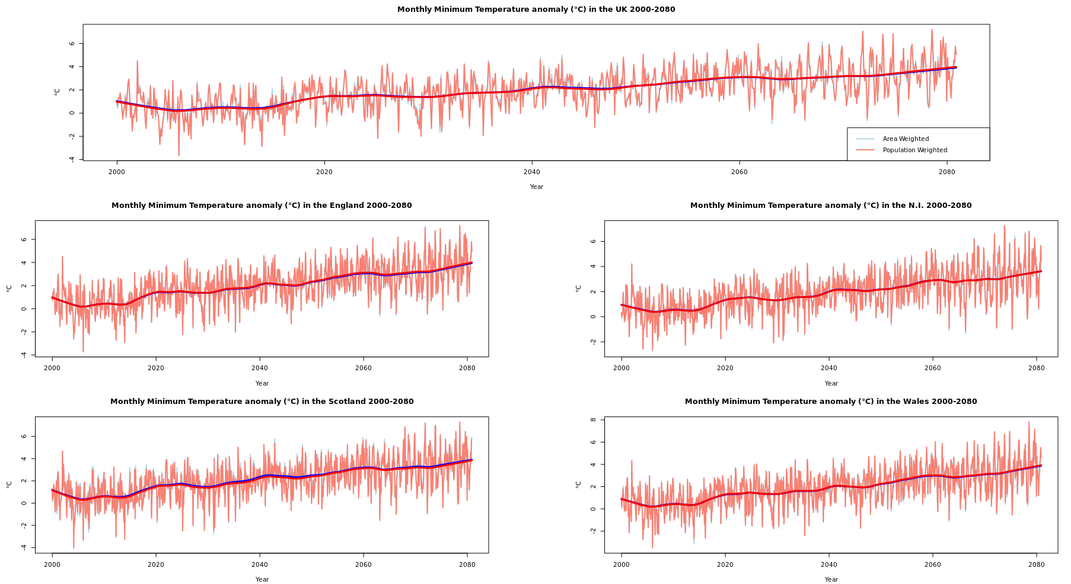

Slide 10
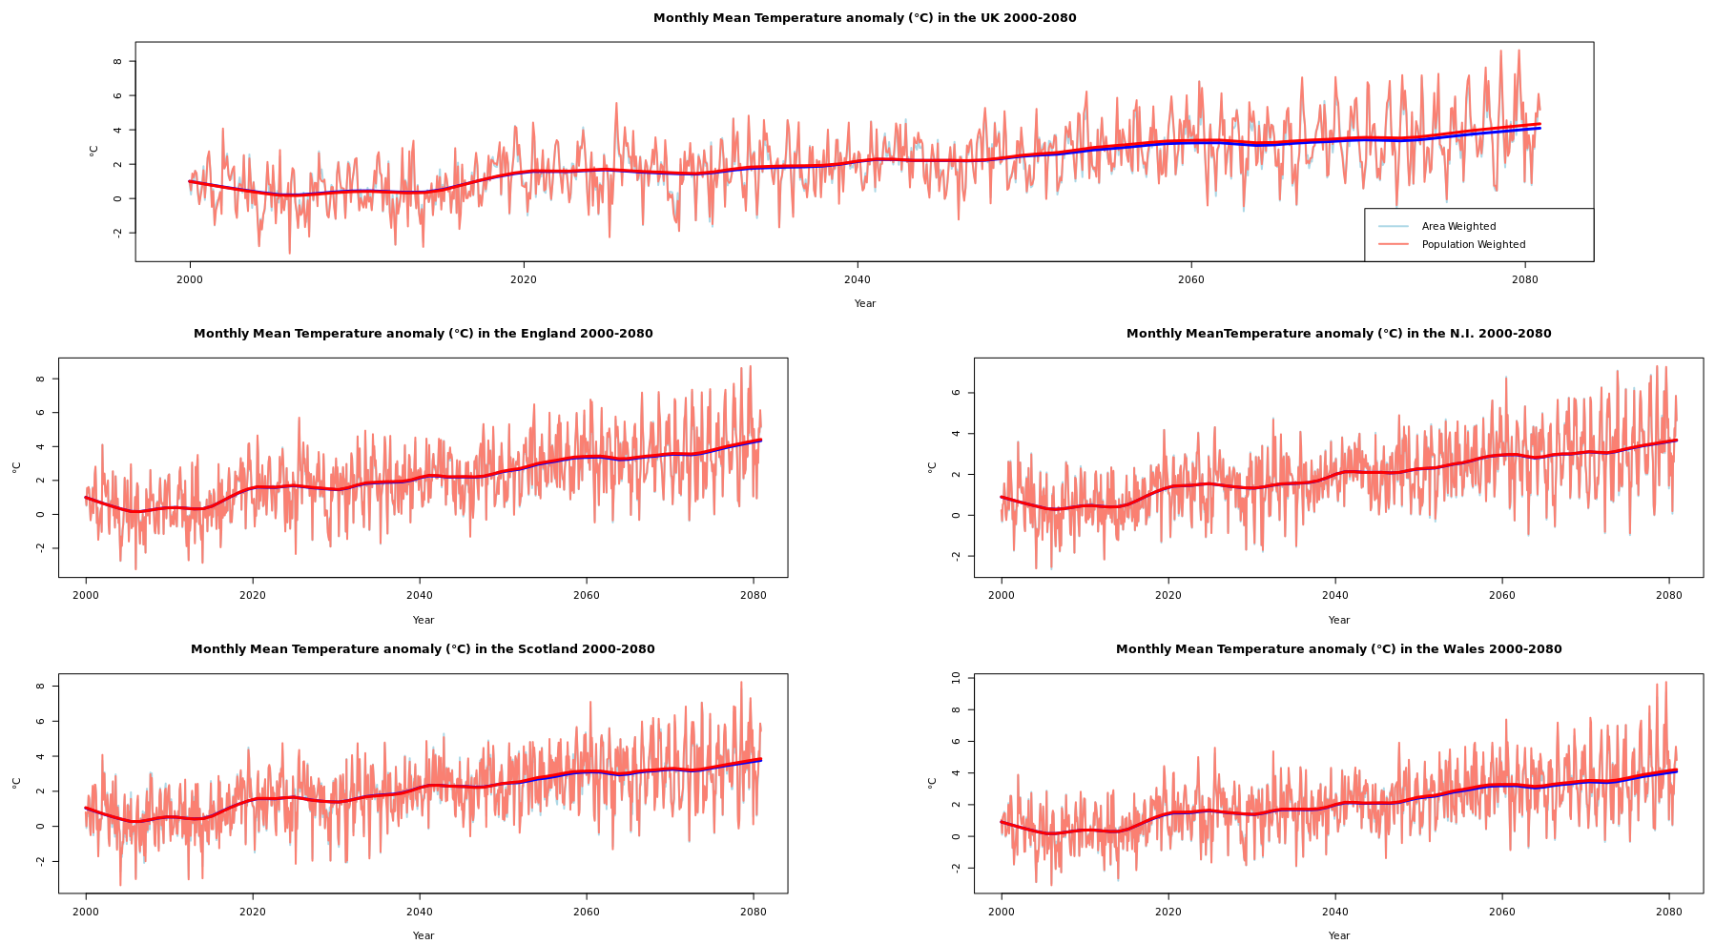

Slide 11
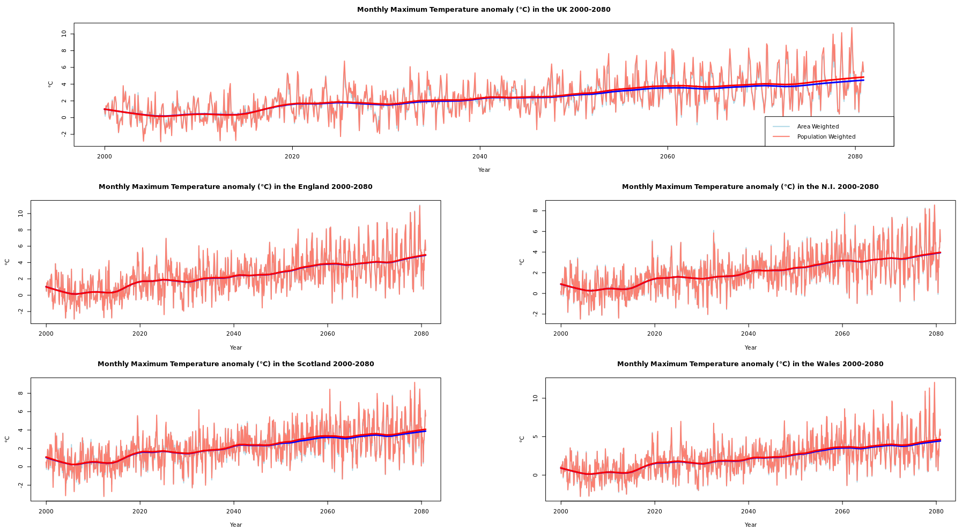

Slide 12
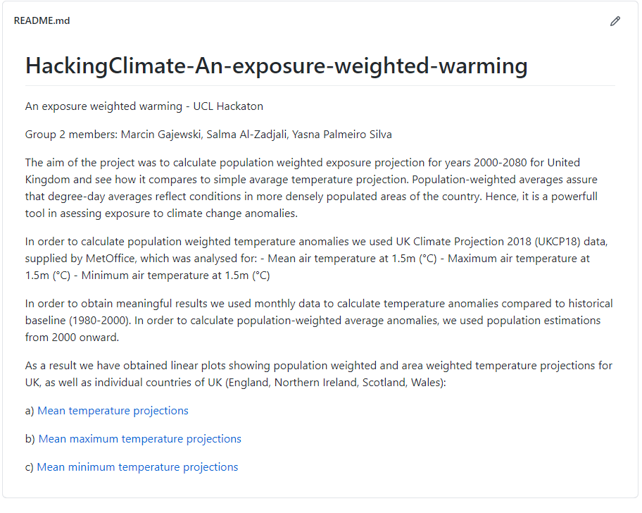

https://bit.ly/3uSC9EV

